Slide 1
Principles of Programming Languages
Unit - I
Preliminary Concepts, Syntax and Semantics

Slide 2
Reasons for Studying Concepts of Programming Languages
Increased capacity to express ideas:-
It is widely believed that the depth at which people can think is influenced by the expressive power of the language in which they communicate their thoughts.
Those with only a weak understanding of natural language are limited in the complexity of their thoughts, particularly in depth of abstraction.
In other words, it is difficult for people to conceptualize structures they cannot describe, verbally or in writing.

Slide 3
.
The language in which they develop software places limits on the kinds of control structures, data structures, and abstractions they can use; thus, the forms of algorithms they can construct are likewise limited.
Improved background for choosing appropriate languages:-
programmers, when given a choice of languages for a new project, use the language with which they are most familiar, even if it is poorly suited for the project at hand.
If these programmers were familiar with a wider range of languages and language constructs, they would be better able to choose the language with the features that best address the problem.

Slide 4
.
Some of the features of one language often can be simulated in another language.
However, it is preferable to use a feature whose design has been integrated into a language than to use a simulation of that feature, which is often less elegant, more cumbersome, and less safe.
Increased ability to learn new languages:-
Once a thorough understanding of the fundamental concepts of languages is acquired, it becomes far easier to see how these concepts are incorporated into the design of the language being learned

Slide 5
.
The same phenomenon occurs in natural languages. The better you know the grammar of your native language, the easier it is to learn a second language. Furthermore, learning a second language has the benefit of teaching you more about your first language.
Finally, it is essential that practicing programmers know the vocabulary and fundamental concepts of programming languages so they can read and understand programming language descriptions and evaluations, as well as promotional literature for languages and compilers. These are the sources of information needed in order to choose and learn a language.

Slide 6
.
Better understanding of the significance of implementation:-
In learning the concepts of programming languages, it is both interesting and necessary to touch on the implementation issues that affect those concepts.
In some cases, an understanding of implementation issues leads to an understanding of why languages are designed the way they are.
In turn, this knowledge leads to the ability to use a language more intelligently, as it was designed to be used.
We can become better programmers by understanding the choices among programming language constructs and the consequences of those choices.

Slide 7
.
Better use of languages that are already known:-
Most contemporary programming languages are large and complex.
Accordingly, it is uncommon for a programmer to be familiar with and use all of the features of a language he or she uses.
By studying the concepts of programming languages, programmers can learn about previously unknown and unused parts of the languages they already use and begin to use those features.

Slide 8
.
Overall advancement of computing:-
Finally, there is a global view of computing that can justify the study of programming language concepts.
Although it is usually possible to determine why a particular programming language became popular, many believe, at least in retrospect, that the most popular languages are not always the best available.
In some cases, it might be concluded that a language became widely used, at least in part, because those in positions to choose languages were not sufficiently familiar with programming language concepts.

Slide 9
.
  Programming Domains
  Computers have been applied to a myriad of different areas, from controlling nuclear power plants to providing video games in mobile phones. Because of this great diversity in computer use, programming languages with very different goal have been developed.
  Scientific Applications:-
  The first digital computers, which appeared in the late 1940s and early 1950s, were invented and used for scientific applications.

Slide 10
.
Typically, the scientific applications of that time used relatively simple data structures, but required large numbers of floating-point arithmetic computations.
The most common data structures were arrays and matrices; the most common control structures were counting loops and selections.
The early high-level programming languages invented for scientific applications were designed to provide for those needs. Their competition was assembly language, so efficiency was a primary concern. The first language for scientific applications was Fortran.

Slide 11
.
Business Applications:-
The use of computers for business applications began in the 1950s.
Special computers were developed for this purpose, along with special languages.
The first successful high-level language for business was COBOL .
Business languages are characterized by facilities for producing elaborate reports, precise ways of describing and storing decimal numbers and character data, and the ability to specify decimal arithmetic operations.

Slide 12
.
Artificial Intelligence:-
Artificial intelligence (AI) is a broad area of computer applications characterized by the use of symbolic rather than numeric computations.
Symbolic computation means that symbols, consisting of names rather than numbers, are manipulated. Also, symbolic computation is more conveniently done with linked lists of data rather than arrays.
This kind of programming sometimes requires more flexibility than other programming domains.
The first widely used programming language developed for AI applications was the functional language Lisp, which appeared in 1959.

Slide 13
.
Most AI applications developed prior to 1990 were written in Lisp or one of its close relatives. During the early 1970s, however, an alternative approach to some of these applications appeared—logic programming using the Prolog language.
    Web Software:-
The World Wide Web is supported by an eclectic collection of languages, ranging from markup languages, such as HTML, which is not a programming language, to general-purpose programming languages, such as Java.
Because of the pervasive need for dynamic Web content, some computation capability is often included in the technology of content presentation.

Slide 14
.
This functionality can be provided by embedding programming code in an HTML document. Such code is often in the form of a scripting language, such as JavaScript or PHP.
  Language Evaluation Criteria
  We will evaluate the features, focusing on their impact on the software development process, including maintenance. To do this, we need a set of evaluation criteria. Such a list of criteria is necessarily controversial, because it is difficult to get even two computer scientists to agree on the value of some given language characteristic relative to others.

Slide 15
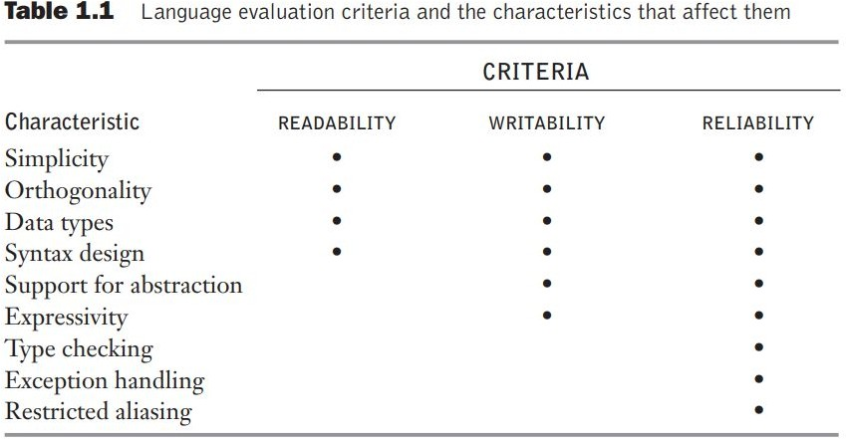
.

Slide 16
.
Readability : the ease with which programs can be read and understood.
Writability : the ease with which a language can be used to create programs.
Reliability : conformance to specifications (i.e., performs to its specifications).
Cost : the ultimate total cost.

Slide 17
.
  Influences on Language Design
  The factors influence the basic design of programming languages. The most important of these are computer architecture and programming design methodologies.
Computer Architecture:-
The basic architecture of computers has had a profound effect on language design.
Most of the popular languages of the past 60 years have been designed around the prevalent computer architecture, called the von Neumann architecture, after one of its originators.

Slide 18
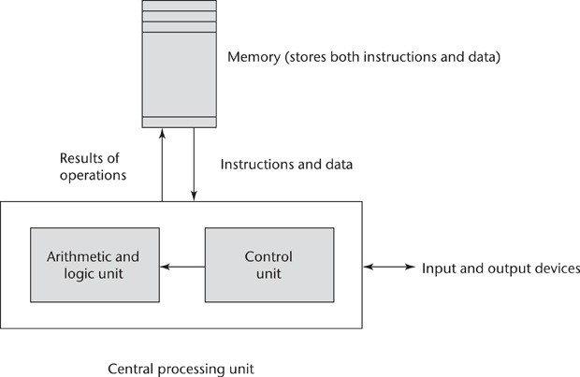
.
In a von Neumann computer, both data and programs are stored in the same memory.

Slide 19
.
The execution of a machine code program on a von Neumann architecture computer occurs in a process called the fetch-execute cycle.
As stated earlier, programs reside in memory but are executed in the CPU.
Each instruction to be executed must be moved from memory to the processor.
The address of the next instruction to be executed is maintained in a register called the program counter.
The fetch-execute cycle can be simply described by the following algorithm:

Slide 20
.
fetch-execute cycle.
initialize the program counter
repeat forever
fetch the instruction pointed to by the program counter increment the program counter to point at the next instruction decode the instruction
execute the instruction
end repeat

Slide 21
.
    Programming Design Methodologies
    The late 1960s and early 1970s brought an intense analysis, begun in large part by the structured-programming movement, of both the software development process and programming language design.
    Shift in the major cost of computing from hardware to software, as hardware costs decreased and programmer costs increased.
    The new software development methodologies that emerged as a result of the research of the 1970s were called top-down design and stepwise refinement.
    The primary programming language deficiencies that were discovered were incompleteness of type checking and inadequacy of control statements

Slide 22
.
In the late 1970s, a shift from procedure-oriented to data-oriented program design methodologies began. Simply put, data-oriented methods emphasize data design, focusing on the use of abstract data types to solve problems.
For data abstraction to be used effectively in software system design, it must be supported by the languages used for implementation
The first language to provide even limited supported for data abstraction was SIMULA67, although the language certainly was not propelled to popularity because of it. The benefits of data abstraction were not widely recognized until the early 1970s. However, most languages designed since the late 1970s support data abstraction,

Slide 23
.
The latest step in the evolution of data-oriented software development, which began in the early 1980s, is object-oriented design. Object-oriented methodology begins with data abstraction, which encapsulates processing with data objects and controls access to data, and adds inheritance and dynamic method binding.
Inheritance is a powerful concept that greatly enhances the potential reuse of existing software, thereby providing the possibility of significant increases in software development productivity. This is an important factor in the increase in popularity of object-oriented languages. Dynamic (run-time) method binding allows more flexible use of inheritance.

Slide 24
.
Object-oriented programming developed along with a language that supported its concepts: Smalltalk (Goldberg and Robson, 1989).
Although Smalltalk never became as widely used as many other languages, support for object-oriented programming is now part of most popular imperative languages, including Java, C++, and C#. Object-oriented concepts have also found their way into functional programming in CLOS.
Procedure-oriented programming is, in a sense, the opposite of data-oriented programming. Although data-oriented methods now dominate software development, procedure-oriented methods have not been abandoned. On the contrary, in recent years, a good deal of research has occurred in procedure- oriented programming, especially in the area of concurrency.
All of these evolutionary steps in software development methodologies led to new language constructs to support them.

Slide 25
.
Language Categories
Programming languages are often categorized into four categories
i. Imperative Languages
ii. Functional Languages
iii. Logic Languages
iv. Object-Oriented Languages
However, we do not consider languages that support object-oriented programming to form a separate category of languages. We have described how the most popular languages that support object-oriented programming grew out of imperative languages.

Slide 26
.
Although the object-oriented software development paradigm differs significantly from the procedure-oriented paradigm usually used with imperative languages, the extensions to an imperative language required to support object-oriented programming are not intensive
For example, the expressions, assignment statements, and control statements of C and Java are nearly identical. (On the other hand, the arrays, subprograms, and semantics of Java are very different from those of C.) Similar statements can be made for functional languages that support object-oriented programming.
Some authors refer to scripting languages as a separate category of programming languages. However, languages in this category are bound together more by their implementation method, partial or full interpretation, than by a common language design

Slide 27
.
However, languages in this category are bound together more by their implementation method, partial or full interpretation, than by a common language design.
That languages that are typically called Scripting languages
among them Perl , JavaScript and Ruby.
However, languages in this category are bound together more by their implementation method, partial or full interpretation, than by a common language design
. In a rule-based language, however, rules are specified in no particular order, and the language implementation system must choose an order in which the rules are used to produce the desired result.
In recent years, a new category of languages has emerged, the
markup/programming hybrid languages.

Slide 28
.
Markup languages are not programming languages. For instance, HTML, the most widely used markup language, is used to specify the layout of information in Web documents.
However, some programming capability has crept into some extensions to HTML and XML.
Among these are the Java Server Pages Standard Tag Library (JSTL) and eXtensible Stylesheet Language Transformations(XSLT).

Slide 29
.
  Language Design Trade-Offs
The programming language evaluation criteria provide a framework for language design. Unfortunately, that framework is self-contradictory.
In his insightful paper on language design, stated that “there are so many important but conflicting criteria, that their reconciliation and satisfaction is a major engineering task.”
Two criteria that conflict are reliability and cost of execution.
For example, the Java language definition demands that all references to array elements be checked to ensure that the index or indices are in their legal ranges. This step adds a great deal to the cost of execution of Java programs that contain large numbers of references to array elements. C does not require index range checking, so C programs execute faster than semantically equivalent Java programs, although Java programs are more reliable. The designers of Java traded execution efficiency for reliability.

Slide 30
.
As another example of conflicting criteria that leads directly to design trade- offs, consider the case of APL. APL includes a powerful set of operators for array operands. Because of the large number of operators, a significant number of new symbols had to be included in APL to represent the operators.
Also, many APL operators can be used in a single, long, complex expression. One result of this high degree of expressivity is that, for applications involving many array operations, APL is very writable. Indeed, a huge amount of computation can be specified in a very small program.
Another result is that APL programs have very poor readability. A compact and concise expression has a certain mathematical beauty but it is difficult for anyone other than the programmer to understand.

Slide 31
.
The conflict between writability and reliability is a common one in language design. The pointers of C++ can be manipulated in a variety of ways, which supports highly flexible addressing of data. Because of the potential
reliability problems with pointers, they are not included in Java.
Examples of conflicts among language design (and evaluation) criteria abound; some are subtle, others are obvious. It is therefore clear that the task of choosing constructs and features when designing a programming language requires many compromises and trade-offs.

Slide 32
.
  Implementation Methods
  Programming Languages can be implemented in three ways:
  1.Compilation
  2.Interpretation
  3. Hybrid Implementation System
  Two of the primary components of a computer are its internal memory and its processor. The internal memory is used to store programs and data. The processor is a collection of circuits that provides a realization of a set of primitive operations, or machine instructions, such as those for arithmetic and logic operations.

Slide 33
.
In most computers, some of these instructions, which are sometimes called macroinstructions, are actually implemented with a set of instructions called microinstructions, which are defined at an even lower level. Because microinstructions are never seen by software, they will not be discussed further here.
The machine language of the computer is its set of instructions. In the absence of other supporting software, its own machine language is the only language that most hardware computers understand.
Theoretically, a computer could be designed and built with a particular high-level language as its machine language, but it would be very complex and expensive.
Furthermore, it would be highly inflexible, because it would be difficult (but not impossible) to use it with other high-level languages.

Slide 34
.
The more practical machine design choice implements in hardware a very low-level language that provides the most commonly needed primitive operations and requires system software to create an interface to programs in higher-level languages.
A language implementation system cannot be the only software on a computer. Also required is a large collection of programs, called the operating system, which supplies higher-level primitives than those of the machine language.
These primitives provide system resource management, input and output operations, a file management system, text and/or program editors, and a variety of other commonly needed functions. Because language implementation systems need many of the operating system facilities, they interface with the operating system rather than directly with the processor.

Slide 35
.
The operating system and language implementations are layered over the machine language interface of a computer. These layers can be thought of as virtual computers, providing interfaces to the user at higher levels. For example, an operating system and a C compiler provide a virtual C computer. With other compilers, a machine can become other kinds of virtual computers. Most computer systems provide several different virtual computers. User programs form another layer over the top of the layer of virtual computers.

Slide 36
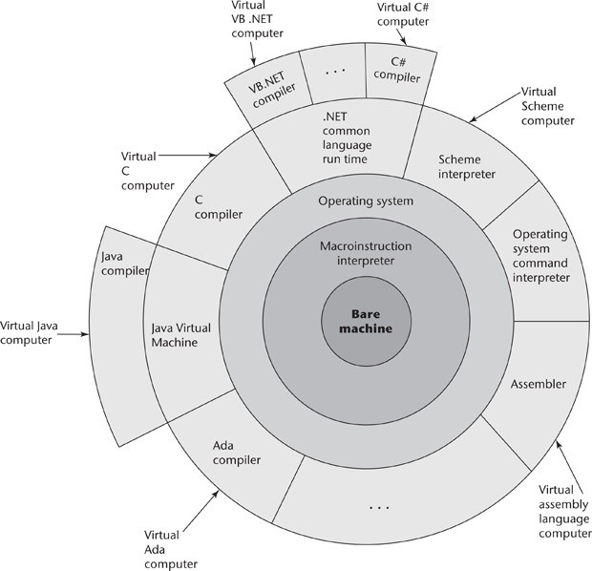
.

Slide 37
.
    Compilation
    Programming languages can be implemented by any of three general methods. At one extreme, programs can be translated into machine language, which can be executed directly on the computer. This method is called a compiler implementation and has the advantage of very fast program execution, once the translation process is complete.
    Most production implementations of languages, such as C, COBOL, and C++, are by compilers.
    The language that a compiler translates is called the source language. The process of compilation and program execution takes place in several phases,

Slide 38
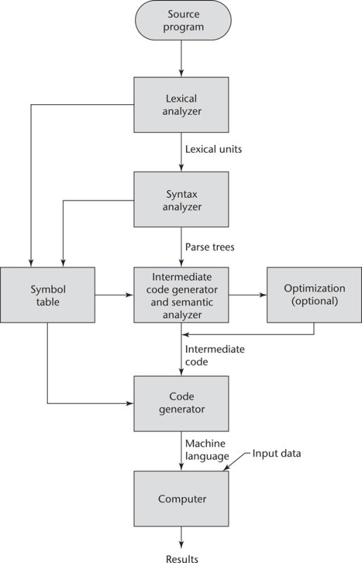
.

Slide 39
.
The lexical analyzer gathers the characters of the source program into lexical units. The lexical units of a program are identifiers, special words, operators, and punctuation symbols. The lexical analyzer ignores comments in the source program because the compiler has no use for them.
The syntax analyzer takes the lexical units from the lexical analyzer and uses them to construct hierarchical structures called parse trees. These parse trees represent the syntactic structure of the program. In many cases, no actual parse tree structure is constructed; rather, the information that would be required to build a tree is generated and used directly.
The intermediate code generator produces a program in a different language, at an intermediate level between the source program and the final output of the compiler.

Slide 40
.
The semantic analyzer is an integral part of the intermediate code generator. The semantic analyzer checks for errors, such as type errors, that are difficult, if not impossible, to detect during syntax analysis.
Optimization, which improves programs (usually in their intermediate code version) by making them smaller or faster or both. Because many kinds of optimization are difficult to do on machine language, most optimization is done on the intermediate code.
The code generator translates the optimized intermediate code version of the program into an equivalent machine language program.

Slide 41
.
The symbol table serves as a database for the compilation process. The primary contents of the symbol table are the type and attribute information of each user-defined name in the program. This information is placed in the symbol table by the lexical and syntax analyzers and is used by the semantic analyzer and the code generator.
The linking operation connects the user program to the system programs by placing the addresses of the entry points of the system programs in the calls to them in the user program. The user and system code together are sometimes called a load module, or executable image. The process of collecting system programs and linking them to user programs is called linking and loading, or sometimes just linking. It is accomplished by a systems program called a linker.

Slide 42
.
The speed of the connection between a computer’s memory and its processor often determines the speed of the computer, because instructions often can be executed faster than they can be moved to the processor for execution.
    Pure Interpretation
Pure interpretation lies at the opposite end (from compilation) among implementation methods. With this approach, programs are interpreted by another program called an interpreter, with no translation whatever.
The interpreter program acts as a software simulation of a machine whose fetch- execute cycle deals with high-level language program statements rather than machine instructions. This software simulation obviously provides a virtual machine for the language.

Slide 43
.
Pure interpretation has the advantage of allowing easy implementation of many source-level debugging operations, because all run-time error messages can refer to source-level units.
For example, if an array index is found to be out of range, the error message can easily indicate the source line of the error and the name of the array.
On the other hand, this method has the serious disadvantage that execution is 10 to 100 times slower than in compiled systems. The primary source of this slowness is the decoding of the high- level language statements, which are far more complex than machine language instructions.
Another disadvantage of pure interpretation is that it often requires more space. In addition to the source program, the symbol table must be present during interpretation. Furthermore, the source program may be stored in a form designed for easy access and modification rather than one that provides for minimal size.

Slide 44
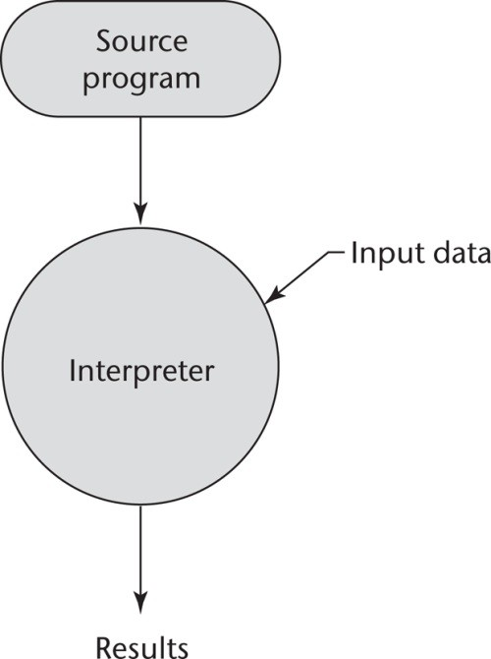
.

Slide 45
.
    Hybrid Implementation Systems
    Some language implementation systems are a compromise between compilers and pure interpreters; they translate high-level language programs to an intermediate language designed to allow easy interpretation. This method is faster than pure interpretation because the source language statements are decoded only once. Such implementations are called hybrid implementation systems.
    Instead of translating intermediate language code to machine code, it simply interprets the intermediate code.
    Perl is implemented with a hybrid system. Perl programs are partially - compiled to detect errors before interpretation and to simplify the interpreter.

Slide 46
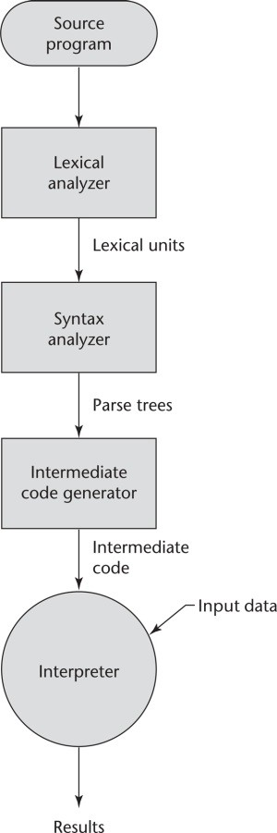
.

Slide 47
.
Initial implementations of Java were all hybrid. Its intermediate form, called byte code, provides portability to any machine that has a byte code interpreter and an associated run-time system.
Sometimes an implementor may provide both compiled and interpreted implementations for a language. In these cases, the interpreter is used to develop and debug programs. Then, after a (relatively) bug-free state is reached, the programs are compiled to increase their execution speed.
    Preprocessors
    A preprocessor is a program that processes a program just before the program is compiled. Preprocessor instructions are embedded in programs. The preprocessor is essentially a macro expander. Preprocessor instructions are commonly used to specify that the code from another file is to be included.

Slide 48
.
  Programming Environments
  A programming environment is the collection of tools used in the development of software.
  This collection may consist of only a file system, a text editor, a linker, and a compiler. Or it may include a large collection of integrated tools, each accessed through a uniform user interface.
  In the latter case, the process of the development and maintenance of software is greatly enhanced. Therefore, the characteristics of a programming language are not the only measure of the software development capability of a system. We now briefly describe several programming environments

Slide 49
.
UNIX is an older programming environment, first distributed in the middle 1970s, built around a portable multiprogramming operating system. It provides a wide array of powerful support tools for software production and maintenance in a variety of languages.
Microsoft Visual Studio .NET is a relatively recent step in the evolution of software development environments. It is a large and elaborate collection of software development tools, all used through a windowed interface. This system can be used to develop software in any one of the five .NET languages: C#, Visual Basic.NET, JScript (Microsoft’s version of JavaScript), F# (a functional language), and C++/CLI.
NetBeans is a development environment that is primarily used for Java application development but also supports JavaScript, Ruby, and PHP. Both Visual Studio and NetBeans are more than development environments—they are also frameworks, which means they actually provide common parts of the code of the application.

Slide 50
.
Describing Syntax and Semantics
Programming language implementors obviously must be able to determine how the expressions, statements, and program units of a language are formed, and also their intended effect when executed.
The difficulty of the implementers job is, in part, determined by the completeness and precision of the language description.
The study of programming languages, like the study of natural languages, can be divided into examinations of syntax and semantics.

Slide 51
.
Syntax: The syntax of a programming language is the form of its expressions, statements, and - program units.
Semantics : semantics is the meaning of those expressions, statements, and program units.
For example, the syntax of a Java while statement is
while (boolean_expr) statement
The semantics of this statement form is that when the current value of the Boolean expression is true, the embedded statement is executed. Then control implicitly returns to the Boolean expression to repeat the process. If the Boolean expression is false, control transfers to the statement following the while construct.

Slide 52
.
syntax and semantics are closely related. In a well-designed programming language, semantics should follow directly from syntax; that is, the appearance of a statement should strongly suggest what the statement is meant to accomplish.
Describing syntax is easier than describing semantics, partly because a concise and universally accepted notation is available for syntax description, but none has yet been developed for semantics.
The General Problem of Describing Syntax
Terminologies
Sentence
Language
Lexeme
Token

Slide 53
.
Sentences: A sentence is a string of characters over some alphabet .
Language : A language is a set of sentences.
The syntax rules of a language specify which strings of characters from the language’s alphabet are in the language.
for example, has a large and complex collection of rules for specifying the syntax of its sentences. By comparison, even the largest and most complex programming languages are syntactically very simple.
Lexeme: A lexeme is the lowest level syntactic unit of a language (e.g., *, sum, begin)
The description of lexemes can be given by a lexical specification, which is usually separate from the syntactic description of the language.

Slide 54
.
The lexemes of a programming language include its numeric literals, operators, and special words, among others. One can think of programs as strings of lexemes rather than of characters.
Lexemes are partitioned into groups—for example, the names of variables, methods, classes, and so forth in a programming language form a group called identifiers.
Token: A token of a language is a category of its lexemes.
For example, an identifier is a token that can have lexemes, or instances, such as sum and total.
In some cases, a token has only a single possible lexeme. For example, the token for the arithmetic operator symbol + has just one possible lexeme.
Consider the following Java statement:
index = 2 * count + 17;

Slide 55
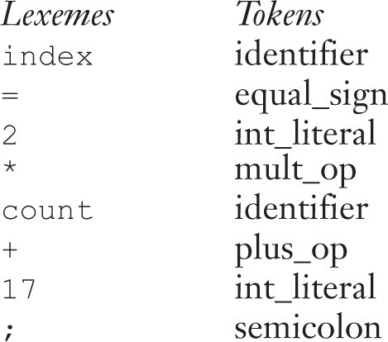
.

Slide 56
.
In general, languages can be formally defined in two distinct ways
    Language Recognizers
    Language Generators
Language Recognizers
Suppose we have a language L that uses an alphabet ∑ of characters. To define L formally using the recognition method, we would need to construct a mechanism R, called a recognition device, capable of reading strings of characters from the alphabet ∑.
R would indicate whether a given input string was or was not in L. In effect, R would either accept or reject the given string. Such devices are like filters, separating legal sentences from those that are incorrectly formed. If R, when fed any string of characters over ∑, accepts it only if it is in L, then R is a description of L.
Because most useful languages are, for all practical purposes, infinite, this might seem like a lengthy and ineffective process. Recognition devices, however, are not used to enumerate all of the sentences of a language—they have a different purpose.

Slide 57
.
Recognition devices, however, are not used to enumerate all of the sentences of a language—they have a different purpose.
The syntax analysis part of a compiler is a recognizer for the language the compiler translates. In this role, the recognizer need not test all possible strings of characters from some set to determine whether each is in the language.
Rather, it need only determine whether given programs are in the language. In effect then, the syntax analyzer determines whether the given programs are syntactically correct. The structure of syntax analyzers, also known as parsers.

Slide 58
.
    Language Generators
A language generator is a device that can be used to generate the sentences of a language. We can think of the generator as having a button that produces a sentence of the language every time it is pushed.
Because the particular sentence that is produced by a generator when its button is pushed is unpredictable, a generator seems to be a device of limited usefulness as a language descriptor.
However, people prefer certain forms of generators over recognizers because they can more easily read and understand them. By contrast, the syntax-checking portion of a compiler (a language recognizer) is not as useful a language description for a programmer because it can be used only in trial-and-error mode.

Slide 59
.
For example, to determine the correct syntax of a particular statement using a compiler, the programmer can only submit a speculated version and note whether the compiler accepts it. On the other hand, it is often possible to determine whether the syntax of a particular statement is correct by comparing it with the structure of the generator.
There is a close connection between formal generation and recognition devices for the same language. This was one of the seminal discoveries in computer science, and it led to much of what is now known about formal languages and compiler design theory.

Slide 60
.
  Formal Methods of Describing Syntax
The formal language-generation mechanisms, usually called grammars, that are commonly used to describe the syntax of programming languages.
    Backus-Naur Form and Context-Free Grammars
In the middle to late 1950s, two men, Noam Chomsky and John Backus, in unrelated research efforts, developed the same syntax description formalism, which subsequently became the most widely used method for programming language syntax.

Slide 61
.
Context-Free Grammars
Developed by Noam Chomsky(linguist) in the mid-1950s
described four classes of generative devices or grammars that define four classes of languages
Two of these grammar classes, named context-free and regular, turned out to be useful for describing the syntax of programming languages.
The forms of the tokens of programming languages can be described by regular grammars.
The syntax of whole programming languages, with minor exceptions, can be described by context- free grammars.
No interest at the time in the artificial languages used to communicate with computers

Slide 62
.
      Backus-Naur Form
After Chomsky’s work ACM-GAMM group began designing ALGOL 58.
A landmark paper describing ALGOL 58 was presented by John Backus, a prominent member of the ACM-GAMM group, at an international conference in 1959
This paper introduced a new formal notation for specifying
programming language syntax.
Later modified slightly by Peter Naur for the description of ALGOL 60 .
This revised method of syntax description became known as
Backus-Naur Form, or simply BNF.

Slide 63
.
BNF is a natural notation for describing syntax.
BNF in the ALGOL 60 report was not immediately accepted by computer users.
It soon became and is still the most popular method of concisely describing programming language syntax.
      Fundamentals
A metalanguage is a language that is used to describe another language.
BNF is a metalanguage for programming languages
BNF uses abstractions for syntactic structures.

Slide 64
.
A simple Java assignment statement, for example, might be represented by the abstraction <assign> (pointed brackets are often used to delimit names of abstractions). The actual definition of <assign> can be given by
<assign> → <var> = <expression>
The text on the left side of the arrow, which is aptly called the left-hand side (LHS), is the abstraction being defined.
The text to the right of the arrow is the definition of the LHS. It is called the right-hand side (RHS) and consists of some mixture of tokens, lexemes, and references to other abstractions.
Altogether, the definition is called a rule, or production. In the example rule just given, the abstractions <var> and <expression> obviously must be defined for the <assign> definition to be useful.

Slide 65
.
This particular rule specifies that the abstraction <assign> is defined as an instance of the abstraction <var>, followed by the lexeme =, followed by an instance of the abstraction <expression>. One example sentence whose syntactic structure is described by the rule is
total = subtotal1 + subtotal2
The abstractions in a BNF description, or grammar, are often called nonterminal symbols, or simply nonterminals, and the lexemes and tokens of the rules are called terminal symbols, or simply terminals. A BNF description, or grammar, is a collection of rules.
Nonterminal symbols can have two or more distinct definitions, representing two or more possible syntactic forms in the language. Multiple definitions can be written as a single rule, with the different definitions separated by the symbol |, meaning logical OR.

Slide 66
.
For example, a Java if statement can be described with the rules
<if_stmt> → if ( <logic_expr> ) <stmt>
<if_stmt> → if ( <logic_expr> ) <stmt> else <stmt> or with the rule
<if_stmt> → if ( <logic_expr> ) <stmt>
| if ( <logic_expr> ) <stmt> else <stmt>
In these rules, <stmt> represents either a single statement or a compound statement.
Although BNF is simple, it is sufficiently powerful to describe nearly all of the syntax of programming languages. In particular, it can describe lists of similar constructs, the order in which different constructs must appear, and nested structures to any depth, and even imply operator precedence and operator associativity.

Slide 67
.
      Describing Lists
Variable-length lists in mathematics are often written using an ellipsis ( . . . );
1, 2, . . . is an example. BNF does not include the ellipsis, so an alternative method is required for describing lists of syntactic elements in programming languages .
For BNF, the alternative is recursion. A rule is recursive if its LHS appears in its RHS. The following rules illustrate how recursion is used to describe lists:
<ident_list> → identifier
| identifier, <ident_list>
This defines <ident_list> as either a single token (identifier) or an identifier followed by a comma and another instance of <ident_list>.

Slide 68
.
      Grammars and Derivations
A grammar is a generative device for defining languages.
The sentences of the language are generated through a sequence of applications of the rules, beginning with a special nonterminal of the grammar called the start symbol.
This sequence of rule applications is called a derivation.
In a grammar for a complete programming language, the start symbol represents a complete program and is often named <program>.
EXAMPLE : A Grammar for a Small Language
<program> → begin <stmt_list> end
<stmt_list> → <stmt>
| <stmt> ; <stmt_list>

Slide 69
.
<stmt> → <var> = <expression>
<var> → A | B | C
<expression> → <var> + <var>
| <var> - <var>
| <var>
A program consists of the special word begin, followed by a list of statements separated by semicolons, followed by the special word end. An expression is either a single variable or two variables separated by either a + or - operator. The only variable names in this language are A, B, and C.
A derivation of a program in this language follows:
<program> => begin <stmt_list> end
=> begin <stmt> ; <stmt_list> end
=> begin <var> = <expression> ; <stmt_list> end

Slide 70
.
=>begin A= <expression> ; <stmt_list> end
=>begin A= <var> + <var> ; <stmt_list> end
=>begin A= B + <var> ; <stmt_list> end
=>begin A= B + C ; <stmt_list> end
=>begin A= B + ; <stmt> end
=>begin A=B+C;<var> = <expression> end
=>begin A=B+C;B = <expression> end
=>begin A=B+C;B = <var> end
=>begin A=B+C;B = C end
This derivation, like all derivations, begins with the start symbol, in this case
<program>. The symbol => is read “derives.” Each successive string in the sequence is derived from the previous string by replacing one of the nonterminals with one of that nonterminal’s definitions

Slide 71
.
Each of the strings in the derivation, including <program>, is called a sentential form.
In this derivation, the replaced nonterminal is always the leftmost nonterminal in the previous sentential form. Derivations that use this order of replacement are called leftmost derivations. The derivation continues until the sentential form contains no nonterminals. That sentential form, consisting of only terminals, or lexemes, is the generated sentence.
EXAMPLE Grammar for Simple Assignment Statements
<assign> → <id> = <expr>
<id> → A| B | C
s <expr> → <id> + <expr>
| <id> * <expr>
| ( <expr>)
| <id>

Slide 72
.
For example, the statement
A = B * ( A + C )
is generated by the leftmost derivation:
<assign> => <id> = <expr>
=> A = <expr>
=> A = <id> * <expr>
=> A = B * <expr>
=> A = B * ( <expr>)
=> A = B * ( <id> + <expr>)
=> A = B * ( A + <expr>)
=> A = B * ( A + <id>)
=> A = B * ( A + C )

Slide 73
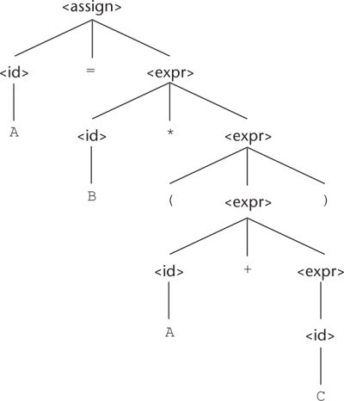
.
      Parse Trees
One of the most attractive features of grammars is that they naturally describe the hierarchical syntactic structure of the sentences of the languages they define. These hierarchical structures are called parse trees.
A parse tree for the simple statement A = B * (A + C)

Slide 74
.
      Ambiguity
A grammar that generates a sentential form for which there are two or more distinct parse trees is said to be ambiguous
An Ambiguous Grammar for Simple Assignment Statements:
<assign> → <id> = <expr>
<id> → A | B | C
<expr> → <expr> + <expr>
| <expr> * <expr>
| ( <expr> )
| <id>
The grammar of is ambiguous because the sentence
A = B + C * A
has two distinct parse trees as shown below

Slide 75
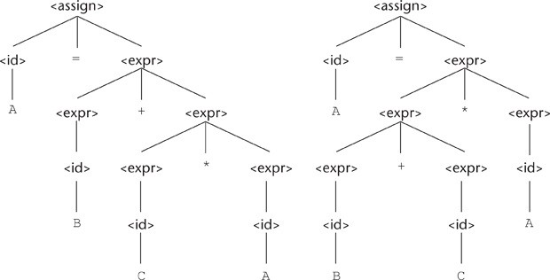
.

Slide 76
.
An Unambiguous Grammar
In above parse tree of a sentence with multiple operators, regardless of the particular operators involved, has the rightmost operator in the expression at the lowest point in the parse tree, with the other operators in the tree moving progressively higher as one moves to the left in the expression.
For example, in the expression A + B * C, * is the lowest in the tree, indicating it is to be done first. However, in the expression A * B + C, + is the lowest, indicating it is to be done first.
A grammar can be written for the simple expressions we have been discussing that is both unambiguous and specifies a consistent precedence of the + and * operators, regardless of the order in which the operators appear in an expression

Slide 77
.
An Unambiguous Grammar for Expressions
<assign> → <id> = <expr>
<id> → A | B | C
<expr> → <expr> + <term>
| <term>
<term> → <term> * <factor>
| <factor>
<factor> → ( <expr> ) | <id>
unambiguous and it specifies the usual precedence order of multiplication and addition operators.
The following derivation of the sentence A = B + C * A uses the grammar

Slide 78
.
<assign> => <id> = <expr>
=> A = <expr>
=> A = <expr> + <term>
=> A = <term> + <term>
=> A = <factor> + <term>
=> A = <id> + <term>
=> A = B + <term>
=> A = B + <term> * <factor>
=> A = B + <factor> * <factor>
=>A=B+<id> * <factor>
=>A=B+C * <factor>
=>A=B+C * <id>
=>A=B+C * A

Slide 79
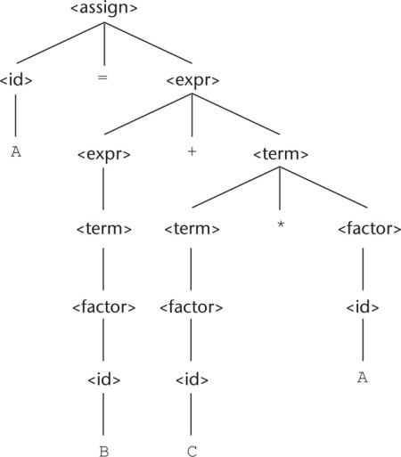
.
The unique parsetree for A = B + C * A using an unambiguous grammar

Slide 80
.
      An Unambiguous Grammar for if-else
The BNF rules for a Java if-else statement are as follows: <if_stmt> → if (<logic_expr>) <stmt>
if (<logic_expr>) <stmt> else <stmt>
If we also have <stmt> → <if_stmt>,
this grammar is ambiguous. The simplest sentential form that illustrates this ambiguity is
if (<logic_expr>) if (<logic_expr>) <stmt> else <stmt>
The two parse trees show the ambiguity of this sentential form. Consider the following example of this construct

Slide 81
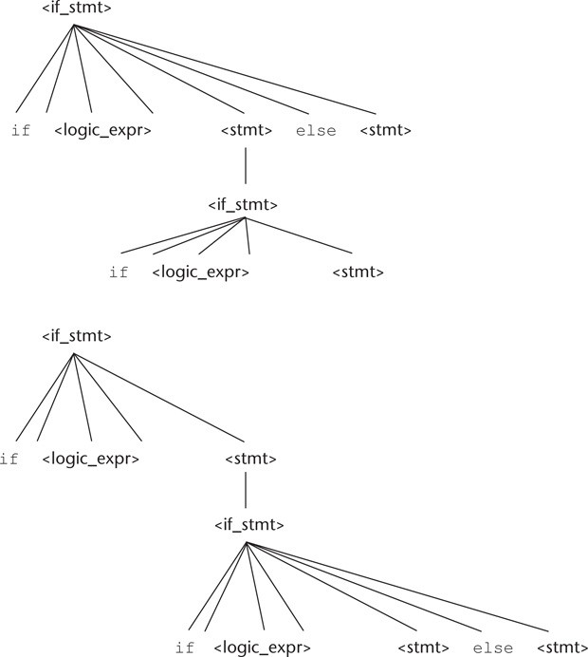
.

Slide 82
.
    Extended BNF
Because of a few minor inconveniences in BNF, it has been extended in several ways. Most extended versions are called Extended BNF, or simply EBNF, even though they are not all exactly the same. The extensions do not enhance the descriptive power of BNF; they only increase its readability and writability.
Three extensions are commonly included in the various versions of EBNF. The first of these denotes an optional part of an RHS, which is delimited by brackets. For example, a C if-else statement can be described as
<if_stmt> → if (<expression>) <statement> [else <statement>]

Slide 83
.
Without the use of the brackets, the syntactic description of this statement would require the following two rules:
<if_stmt> → if (<expression>) <statement>
|if (<expression>) <statement> else <statement>
The second extension is the use of braces in a RHS to indicate that the enclosed part can be repeated indefinitely or left out altogether. This extension allows lists to be built with a single rule, instead of using recursion and two rules. For example, lists of identifiers separated by commas can be described by the following rule:
<ident_list> → <identifier> {, <identifier>}
This is a replacement of the recursion by a form of implied iteration; the part enclosed within braces can be iterated any number of times.

Slide 84
.
The third common extension deals with multiple-choice options. When a single element must be chosen from a group, the options are placed in parentheses and separated by the OR operator, |. For example,
<term> → <term> (* | / | %) <factor>
In BNF, a description of this <term> would require the following three rules: <term> → <term> * <factor>
| <term> / <factor>
| <term> % <factor>
The brackets, braces, and parentheses in the EBNF extensions are metasymbols, which means they are notational tools and not terminal symbols in the syntactic entities they help describe.

Slide 85
.
BNF and EBNF Versions of an Expression Grammar example
BNF:
<expr> → <expr> + <term>
| <expr> - <term>
| <term>
<term> → <term> * <factor>
| <term> / <factor>
| <factor>
<factor> → <exp> ** <factor> <exp>
<exp> → (<expr>)
| id

Slide 86
.
EBNF:
<expr> → <term> {(+ | -) <term>}
<term> → <factor> {(* | /) <factor>} <factor> → <exp> { ** <exp>}
<exp> → (<expr>) | id
The BNF rule
<expr> → <expr> + <term>
clearly specifies—in fact forces—the + operator to be left associative. However, the EBNF version,
<expr> → <term> {+ <term>}

Slide 87
.
  Attribute Grammars
An attribute grammar is a device used to describe more of the structure of a programming language than can be described with a context-free grammar.
An attribute grammar is an extension to a context-free grammar. The extension allows certain language rules to be conveniently described, such as type compatibility.
Static Semantics:
There are some characteristics of programming languages that are difficult to describe with BNF, and some that are impossible. As an example of a syntax rule that is difficult to specify with BNF, consider type compatibility rules.
The static semantics of a language is only indirectly related to the meaning of programs during execution; rather, it has to do with the legal forms of programs (syntax rather than semantics).

Slide 88
.
    Intrinsic Attributes:
    Intrinsic attributes are synthesized attributes of leaf nodes whose values are determined outside the parse tree.
    For example, the type of an instance of a variable in a program could come from the symbol table, which is used to store variable names and their types
    Examples of Attribute Grammars
when there is more than one occurrence of a nonterminal in a syntax rule in an attribute grammar, the nonterminals are subscripted with brackets to distinguish them.
Neither thesubscripts nor the brackets are part of the described language.

Slide 89
.
Syntax rule: <proc_def> → procedure <proc_name>[1]
<proc_body> end <proc_name>[2]; Predicate: <proc_name>[1]string == <proc_name>[2].string
In this example, the predicate rule states that the name string attribute of the
<proc_name> nonterminal in the subprogram header must match the name string attribute of the <proc_name> nonterminal following the end of the subprogram.
The syntax portion of our example attribute grammar is <assign> → <var> = <expr>
<expr> → <var> + <var>
| <var>
<var> → A | B | C

Slide 90
.
An Attribute Grammar for Simple Assignment Statements
Syntax rule: <assign> → <var> = <expr>
Semantic rule: <expr>.expected_type ← <var>.actual_type
Syntax rule: <expr> → <var>[2] + <var>[3]
Semantic rule: <expr>.actual_type ←
if (<var>[2].actual_type = int) and
(<var>[3].actual_type = int) then int
else real
end if
Predicate: <expr>.actual_type == <expr>.expected_type
Syntax rule: <expr> → <var>
Semantic rule: <expr>.actual_type ← <var>.actual_type Predicate: <expr>.actual_type == <expr>.expected_type
Syntax rule: <var> → A | B | C
Semantic rule: <var>.actual_type ← look-up(<var>.string)

Slide 91
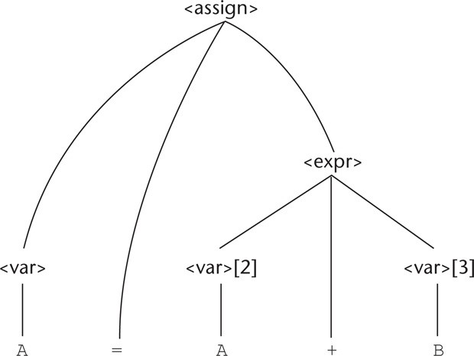
.

Slide 92
.
  Describing the Meanings of Programs: Dynamic Semantics
There are several different reasons underlying the need for a methodology and notation for describing semantics.
Programmers obviously need to know precisely what the statements of a language do before they can use them effectively in their programs.
Compiler writers must know exactly what language constructs mean to design implementations for them correctly. If there were a precise semantics specification of a programming language, programs written in the language potentially could be proven correct without testing.
Also, compilers could be shown to produce programs that exhibited exactly the behavior given in the language definition; that is, their correctness could be verified

Slide 93
.
Finally, language designers, who would develop the semantic descriptions of their languages, could in the process discover ambiguities and inconsistencies in their designs.
Software developers and compiler designers typically determine the semantics of programming languages by reading English explanations in language manuals.
Because such explanations are often imprecise and incomplete, this approach is clearly unsatisfactory. Due to the lack of complete semantics specifications of programming languages, programs are rarely proven correct without testing, and commercial compilers are never generated automatically from language descriptions.
Scheme, a functional language described in is one of only a few programming languages whose definition includes a formal semantics description

Slide 94
.
    Operational Semantics:
The idea behind operational semantics is to describe the meaning of a statement or program by specifying the effects of running it on a machine.
The effects on the machine are viewed as the sequence of changes in its state, where the machine’s state is the collection of the values in its storage.
An obvious operational semantics description, then, is given by executing a compiled version of the program on a computer. Most programmers have, on at least one occasion, written a small test program to determine the meaning of some programming language construct, often while learning the language.
Essentially, what such a programmer is doing is using operational semantics to determine the meaning of the construct.

Slide 95
.
There are different levels of uses of operational semantics. At the highest level, the interest is in the final result of the execution of a complete program. This is sometimes called natural operational semantics.
At the lowest level, operational semantics can be used to determine the precise meaning of a program through an examination of the complete sequence of state changes that occur when the program is executed. This use is sometimes called structural operational semantics.
The basic process of operational semantics is not unusual. In fact, the concept is frequently used in programming textbooks and programming language reference manuals. For example, the semantics of the C for construct can be described in terms of simpler statements, as in

Slide 96
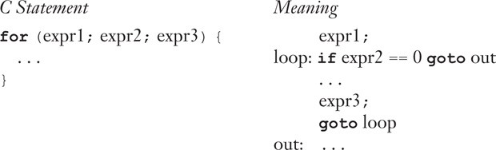
.
    Denotational Semantics:
    Denotational semantics is the most rigorous and most widely known formal method for describing the meaning of programs.
    It is solidly based on recursive function theory. A thorough discussion of the use of denotational semantics to describe the semantics of programming languages is necessarily long and complex.

Slide 97
.
    It is our intent to provide the reader with an introduction to the central concepts of denotational semantics, along with a few simple examples that are relevant to programming language specifications.
    The process of constructing a denotational semantics specification for a programming language requires one to define for each language entity both a mathematical object and a function that maps instances of that language entity onto instances of the mathematical object.
    The idea is based on the fact that there are rigorous ways of manipulating mathematical objects but not programming language constructs. The difficulty with this method lies in creating the objects and the mapping functions.
    The method is named denotational because the mathematical objects denote the meaning of their corresponding syntactic entities.

Slide 98
.
The mapping functions of a denotational semantics programming language specification, like all functions in mathematics, have a domain and a range.
The domain is the collection of values that are legitimate parameters to the function; the range is the collection of objects to which the parameters are mapped.
In denotational semantics, the domain is called the syntactic domain, because it is syntactic structures that are mapped. The range is called the semantic domain.
Denotational semantics is related to operational semantics. In operational semantics, programming language constructs are translated into simpler programming language constructs, which become the basis of the meaning of the construct.

Slide 99
.
In denotational semantics, programming language constructs are mapped to mathematical objects, either sets or, more often, functions.
However, unlike operational semantics, denotational semantics does not model the step-by-step computational processing of programs.
Two Simple Examples
We use a very simple language construct, character string representations of binary numbers, to introduce the denotational method. The syntax of such binary numbers can be described by the following grammar rules:
<bin_num> → '0'
| '1'
| <bin_num> '0'
| <bin_num> '1'
A parse tree for the example binary number

Slide 100
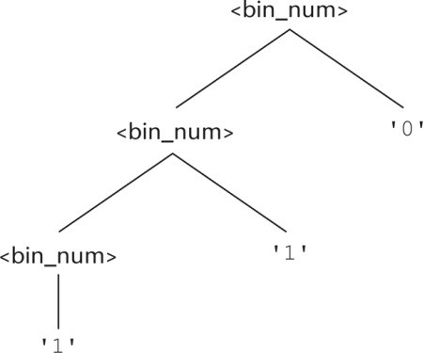
.
Notice that we put apostrophes around the syntactic digits to show they are not mathematical digits. This is similar to the relationship between ASCII coded digits and mathematical digits. When a program reads a number as a string, it must be converted to a mathematical number before it can be used as a value in the program.

Slide 101
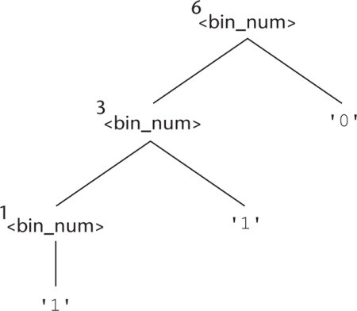
.
The semantic function, named Mbin, maps the syntactic objects, as described in the previous grammar rules, to the objects in N, the set of non-negative decimal numbers. The function Mbin is defined as follows:
Mbin ('0') = 0
Mbin ('1') = 1
Mbin (<bin_num> '0') = 2 * Mbin (<bin_num>)
Mbin (<bin_num>'1') = 2 * Mbin (<bin_num>) + 1

Slide 102
.
Axiomatic Semantics:
Axiomatic semantics, thus named because it is based on mathematical logic, is the most abstract approach to semantics specification .
Rather than directly specifying the meaning of a program, axiomatic semantics specifies what can be proven about the program. Recall that one of the possible uses of semantic specifications is to prove the correctness of programs.
In axiomatic semantics, there is no model of the state of a machine or program or model of state changes that take place when the program is executed.
The meaning of a program is based on relationships among program variables and constants, which are the same for every execution of the program.

Slide 103
.
Axiomatic semantics has two distinct applications: program verification and program semantics specification
Axiomatic semantics was defined in conjunction with the development of an approach to proving the correctness of programs
Such correctness proofs, when they can be constructed, show that a program performs the computation described by its specification. In a proof, each statement of a program is both preceded and followed by a logical expression that specifies constraints on
program variables.
These, rather than the entire state of an abstract machine (as with operational semantics), are used to specify the meaning of the statement. The notation used to describe constraints—indeed, the language of axiomatic semantics—is predicate calculus. Although simple Boolean expressions are often adequate to express constraints, in some cases they are not.
When axiomatic semantics is used to specify formally the meaning of a statement, the meaning is defined by the statement’s effect on assertions about the data affected by the statement.

Slide 104
.
      Assertions:
      The logical expressions used in axiomatic semantics are called predicates, or assertions.
      An assertion immediately preceding a program statement describes the constraints on the program variables at that point in the program.
      An assertion immediately following a statement describes the new constraints on those variables (and possibly others) after execution of the statement.
      These assertions are called the precondition and postcondition, respectively, of the statement. For two adjacent statements, the postcondition of the first serves as the precondition of the second.
      Developing an axiomatic description or proof of a given program requires that every statement in the program has both a precondition and a postcondition.

Slide 105
.
As a simple example, consider the following assignment statement and postcondition:
sum = 2 * x + 1 {sum > 1}
Precondition and postcondition assertions are presented in braces to distinguish them from parts of program statements. One possible precondition for this statement is {x > 10}.
In axiomatic semantics, the meaning of a specific statement is defined by itsprecondition and its postcondition. In effect, the two assertions specify precisely the effect of executing the statement.
The more general concept of axiomatic semantics is to state precisely the meaning of statements and programs in terms of logic expressions. Program verification is one application of axiomatic descriptions of languages.

Slide 106
.
      Weakest Preconditions
      The weakest precondition is the least restrictive precondition that will guarantee the validity of the associated postcondition.
      If the weakest precondition can be computed from the most general postcondition for each of the statement types of a language, then the processes used to compute these preconditions provide a concise description of the semantics of that language.
      An inference rule is a method of inferring the truth of one assertion on the basis of the values of other assertions.
      The general form of an inference rule is as follows:
S1, S2, …, SnS
This rule states that if S1, S2, . . . , and Sn are true, then the truth of S can be inferred. The top part of an inference rule is called its antecedent; the bottom part is called its consequent.

Slide 107
.
An axiom is a logical statement that is assumed to be true. Therefore, an axiom is an inference rule without an antecedent.
For some program statements, the computation of a weakest precondition from the statement and a postcondition is simple and can be specified by an axiom. In most cases, however, the weakest precondition can be specified only by an inference rule.
To use axiomatic semantics with a given programming language, whether for correctness proofs or for formal semantics specifications, either an axiom or an inference rule must exist for each kind of statement in the language. In the following subsections, we present an axiom for assignment statements and inference rules for statement sequences, selection statements, and logical pretest loop statements. Note that we assume that neither arithmetic nor - Boolean expressions have side effects.

